Slide 1

Miniproject(19AI701) – Final Review
Kitchen Utensils Classification using CNN
Submitted by:
BALAJI K (212221230011)
SOMEAVAR R (212221230103)
2020-2024 Batch
TEAM NO:DS15
Under the guidance of:
Mr.K.S.Dhinesh Kumar
Designation,Department of AIDS
DEPARTMENT OF ARTIFICIAL INTELLIGENCE AND DATA SCIENCE
SAVEETHA ENGINEERING COLLEGE
(Autonomous Institution – UGC, Govt. of India)
(Affiliated to Anna University, Approved by AICTE - Accredited by NBA & NAAC – ‘A’ Grade - ISO 9001:2015 Certified)
Saveetha Nagar, Thandalam, Chennai-602 105, TamilNadu, INDIA.

Slide 2
Agenda
Introduction
Problem statement
Literature review summary
Methodology/Flow
Algorithms used
Learnings from the project
Conclusion and Future work
References

Slide 3
Introduction
Image classification is a fundamental task in computer vision with a wide range of applications.
From medical diagnosis to autonomous driving.
The ability to accurately categorize images is crucial for the development of intelligent systems.
In this literature review, we explore the key components of a project that uses TensorFlow and CNN model for kitchen image classification.

Slide 4
Problem Statement
Kitchenware refers to a variety of products that are used in the kitchen for cooking, cutting vegetables, baking, eating etc. These products can include cups, glasses, plates, spoons, forks and knives.
To solve this problem, we'll develop a deep learning model that can accurately classify kitchenware images into the appropriate categories.
This will require collecting and labeling a large dataset of kitchenware images, and training a model on this dataset to learn the visual features and patterns that distinguish different types of kitchen wares.

Slide 5
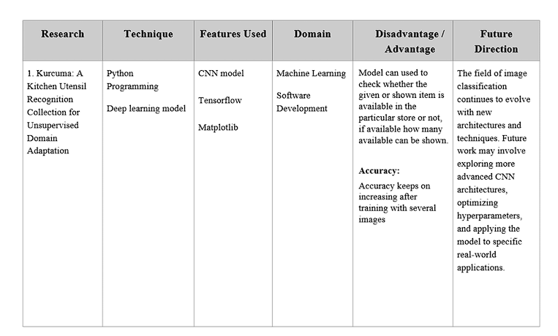
Summary of LR

Slide 6
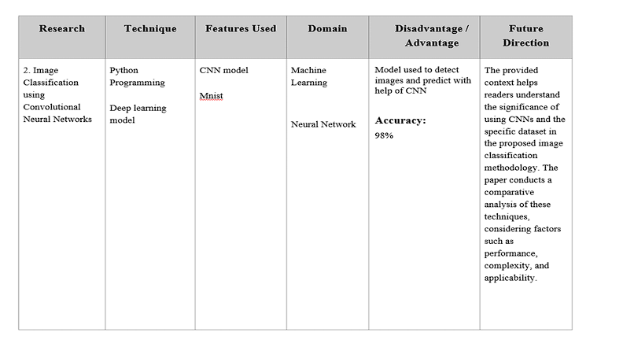
Summary of LR

Slide 7
Scope of the project/Limitations
❏DishWasher: The primary purpose is to assist users in the diagnosis of utensils. Early detection can lead to more effective options and improved predicting outcomes.
❏Efficiency: Predicting the image can stop the problem that arises in the dishwasher.
❏Departmental store: Images can be used to scanned and the responding info about the image can be shown like name, in which floor, and how many?
❏Reduced Workload: By automating the initial screening of utensils images, the system can help reduce the workload of labour and others, making the diagnostic process more efficient.

Slide 8
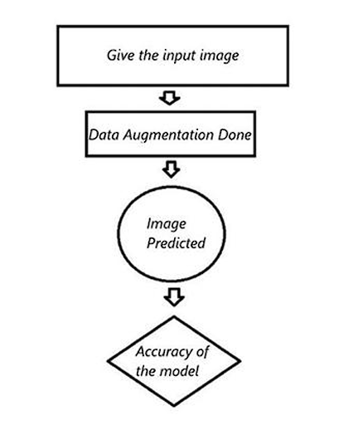
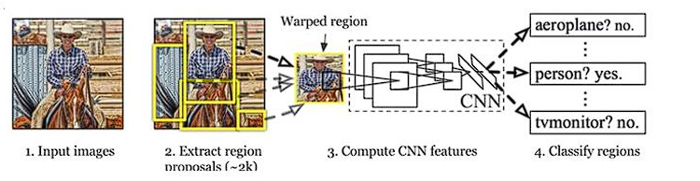
Architecture Diagram

Slide 9
Algorithms used
Importing necessary packages like matplotlib, split folder, tensorflow, etc.,
Loading the datasets from the kaggle which we used.
Splitting the dataset like training and testing.
Training includes 800 images and testing includes 100 images.
Implementing data transformation to the input image and loading to the model.
After training the model(epochs=5) prediction is been done.

Slide 10
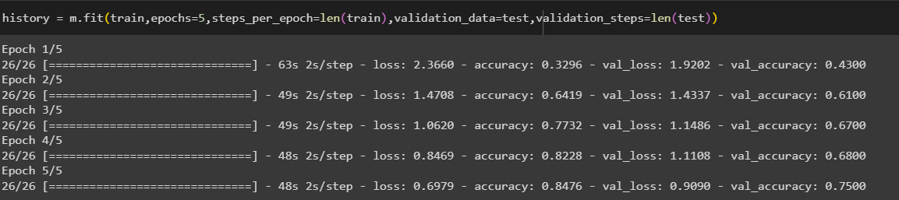
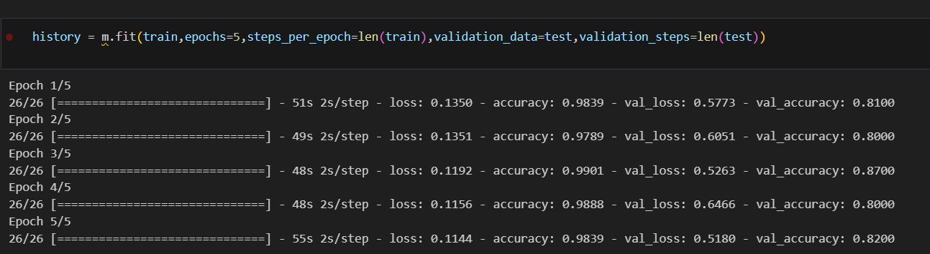
Difference between our reference paper:
Kurcuma model Vs Our model:

Slide 11
Learnings from the project
Deep Learning Fundamentals:
Gain a solid understanding of deep learning principles by working with Convolutional Neural Networks (CNNs) and exploring how they are applied to image classification tasks, particularly in the context of kitchen utensils classification.
Data Preprocessing Techniques:
Develop skills in data preprocessing for utensils images, including techniques such as resizing, normalization, and augmentation. Understand how these steps contribute to preparing data for CNN-based utensils detection.
Model Customization and Fine-tuning:
Explore the process of customizing a pre-trained model for a specific task. Understand how to modify architecture, particularly the fully connected layers, to adapt the model for kitchen classification images.
Evaluation and Optimization Strategies:
Learn how to assess the performance of a CNN model for kitchen utensils using metrics like accuracy. Gain insights into strategies for optimizing hyperparameters to achieve better results, fostering a deeper understanding of model tuning and refinement.

Slide 12
Conclusion&Future work
Using this model, we can reduce client-management interaction thus reducing the rush and crowds in stores and in public places etc.,
In future, this model can be developed into an application by using openCV and other IOT applications so that it can be used as software in mobile for both customer and industries.

Slide 13
References
Book Reference:
Kurcuma: a kitchen utensil recognition collection for unsupervised domain adaptation( 24 January 2023)
Image Classification using Convolutional Neural Networks (M.Vijay Anand Professor, Department of Computer Science and Engineering Saveetha Engineering College, Chennai, India mvijay200304@yahoo.co.in )

